Slide 1
Which is
worse?
Poisons in
nature
Potluck
Keep them
safe
Choose
wisely
100
100
100
100
100
200
200
200
200
200
300
300
300
300
300
400
400
400
400
400
500
500
500
500
500

Slide 2
Both are serious poisonings, but which of these kills the most people each year?
Rattlesnake bites
Alcohol

Slide 3
2: Alcohol
Snakebite deaths = average of less than 6 per year.
Alcohol deaths = average of 6 per day.
Notes:
ANSWER: C—alcohol overdoses.
DISCUSSION: According to the American Association of Poison Control Centers (AAPCC), there are approximately 50,000 cases of a bite or a sting from a venomous animal (snake, spider, etc.) reported each year. However, an average of less than 6 of those victims end up dying from their bite or sting. In contrast, the U.S. Centers for Disease Control and Prevention (CDC) reports that approximately 6 people a day die from alcohol overdose. While many adults can enjoy moderate amounts of alcohol safely, accidental overdoses are a leading cause of poisoning. And alcohol is particularly dangerous to young children, even in very small doses. [photo: Amy Winehouse, a singer/songwriter who died from alcohol overdose in 2011.]
*CDC – Vital Signs – Alcohol Poisoning Deaths. https://www.cdc.gov/vitalsigns/alcohol-poisoning-deaths/index.html. October 20, 2018.

Slide 4
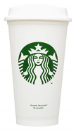
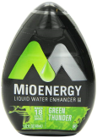
Which of these has the most caffeine?
One 16 oz. Starbucks latte.
One 16 oz. Monster energy drink.
One bottle (1.62 oz.) MiO Energy mixed with water.

Slide 5
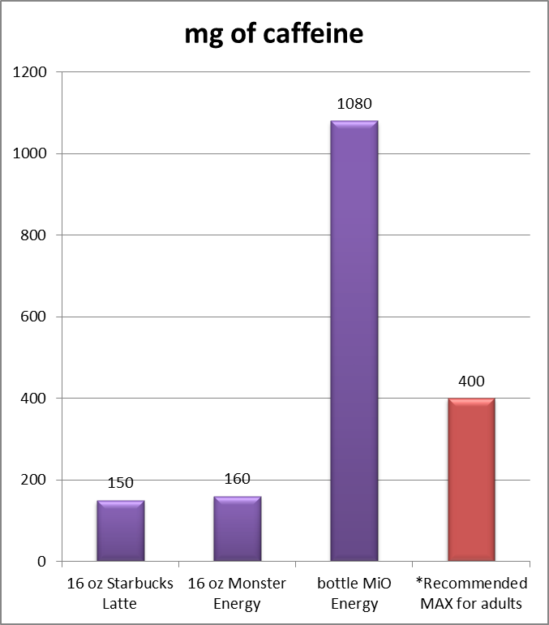
C. One bottle MiO Energy.
Notes:
ANSWER: D-- One bottle MiO Energy.
DISCUSSION: One serving of MiO is supposed to be ½ teaspoon mixed with water. However, some people use way too much. If someone goes through an entire bottle of MiO in just one day, that would mean they ingested 1,080 mg of caffeine. That is like drinking about seven 16 oz. lattes or Monster brand energy drinks.
Too much caffeine can cause nausea, vomiting, trembling, difficulty sleeping, and dangerous changes in heart rhythm. Though rare, cases of extreme overdose could cause seizures and even death. This happened in 2014 when an Ohio teen purchased some powdered caffeine from the internet and misunderstood how concentrated it was before consuming a deadly amount (one teaspoon contained as much caffeine as 25 cups of coffee).
[Note to organizers: The website Caffeine Informer is a good, unbiased resource for determining the caffeine content of beverages. https://www.caffeineinformer.com/the-caffeine-database]

Slide 6
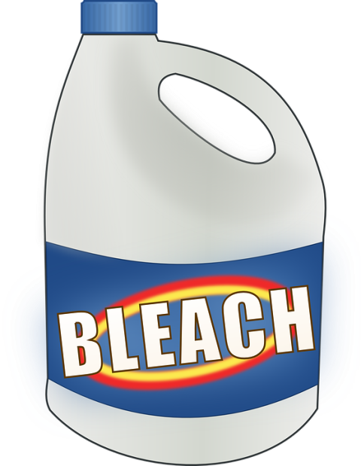
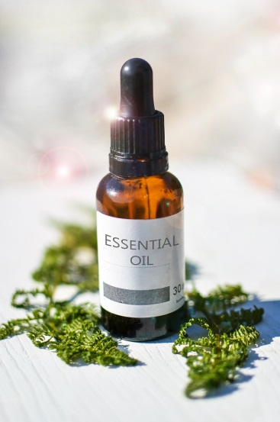
Which of the following could be dangerous to swallow?
A spoonful of oil of wintergreen (an essential oil used to make soap, candles, etc.)
A spoonful of bleach.

Slide 7
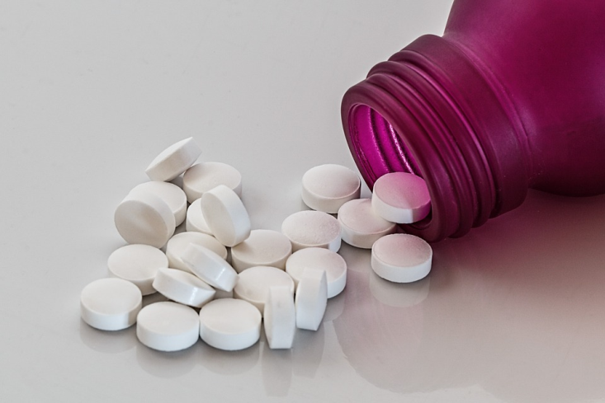
A: A spoonful of oil of wintergreen.
Notes:
ANSWER: A spoonful of oil of wintergreen.
DISCUSSION: Oil of wintergreen contains an ingredient that is a form of aspirin. The aspirin level is highly concentrated. A deadly aspirin overdose could result if oil of wintergreen is swallowed. In fact, as little as one teaspoon could be deadly to a small child. Many other essential oils are poisonous, too, and should always be kept out of the sight and reach of children.
Swallowing one spoonful of household laundry bleach would likely cause minor mouth & throat irritation and stomach upset at worst. It would not be considered a toxic dose.

Slide 8
Anthony is at his grandparents’ house. He finds a bottle of Gatorade® brand sports drink in the pantry and takes a big swallow…it tastes terrible! His grandma was using the Gatorade bottle to store something else. Which of the following would be the most dangerous product for Anthony to accidentally drink?
Liquid fabric softener
Drain clog remover
5% Acetic acid

Slide 9
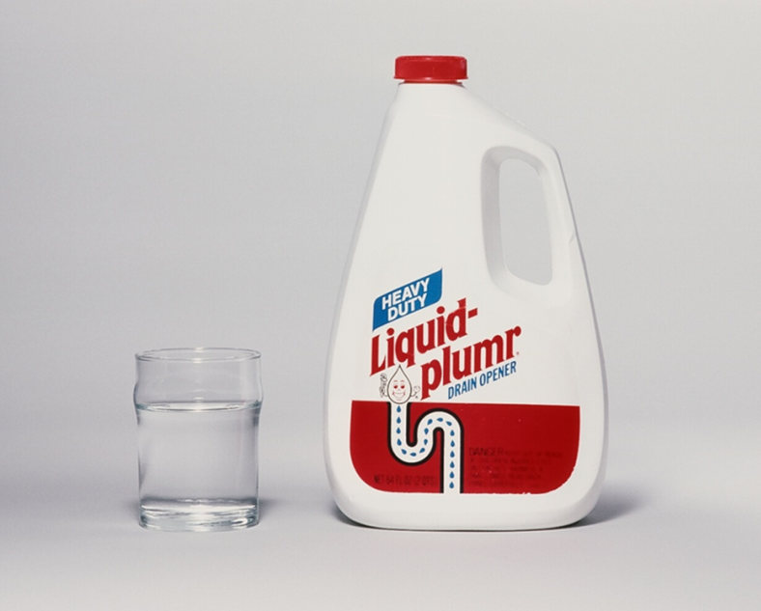
B. Drain clog remover
Notes:
ANSWER: B – Drain clog remover.
DISCUSSION: One swallow of liquid fabric softener may cause an upset stomach or vomiting at worst. Acetic acid 5% sounds like a dangerous chemical, but it is actually regular (“food grade”) vinegar. Drain clog remover, however, is a very toxic chemical which is caustic, meaning it can cause chemical burns instantly on contact. If someone swallowed drain clog remover, it could result in burns to the mouth, throat, esophagus, and stomach. This type of injury could be fatal.
Transferring harmful products into containers that look like food or drink is dangerous, and is a leading cause of poisoning accidents. It’s easy to make a mistake!

Slide 10
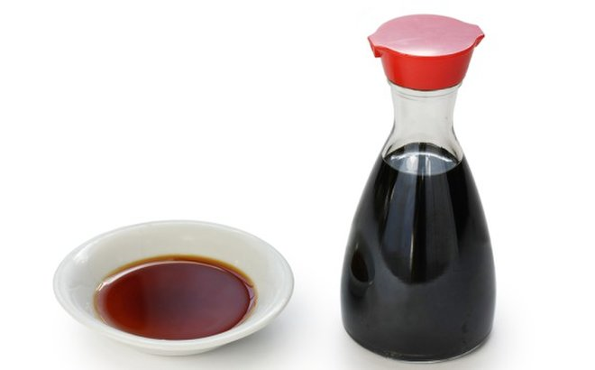
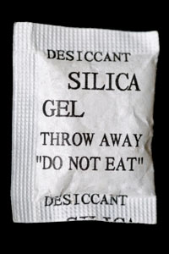
Which is worse?
Drinking an entire 20 ounce bottle of soy sauce.
Swallowing a silica gel desiccant packet.

Slide 11
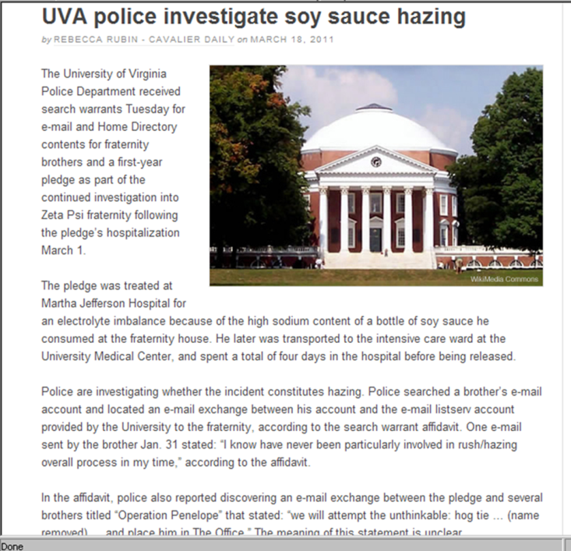
A. Drinking an entire bottle of soy sauce.
Notes:
ANSWER: A—drinking 20 ounces of soy sauce.
DISCUSSION: This question is based on a real-life case in which a college student drank an entire bottle of soy sauce on a dare, as part of a hazing ritual to join a fraternity. This resulted in an overdose of sodium…also known as salt poisoning.
His friends took him to the emergency department when he began having seizures. He remained in a coma and very sick in the intensive care unit for several days and nearly died. With excellent care he did eventually recover fully.
Almost any substance could be poisonous if too much of it gets into the body. You can overdose on substances that are normally harmless in smaller amounts, such as ordinary salt.
Surprise! Silica gel desiccant is not poisonous. It could be a choking hazard, however, especially to children. That is why is says DO NOT EAT in big letters. But it won’t make you sick.

Slide 12
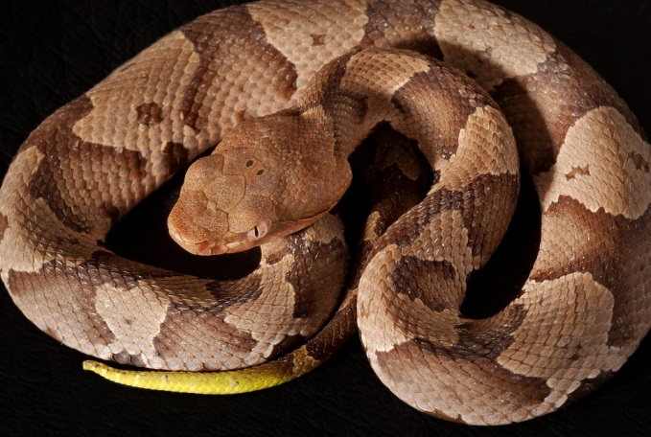
What should you do if a venomous copperhead snake bites you?
Stay calm and go to the nearest hospital.
Wrap something tight above the bite to keep the venom from spreading.
Call your lawyer to make sure your will is up to date.
Cut the bite wound open and suck out the venom.

Slide 13
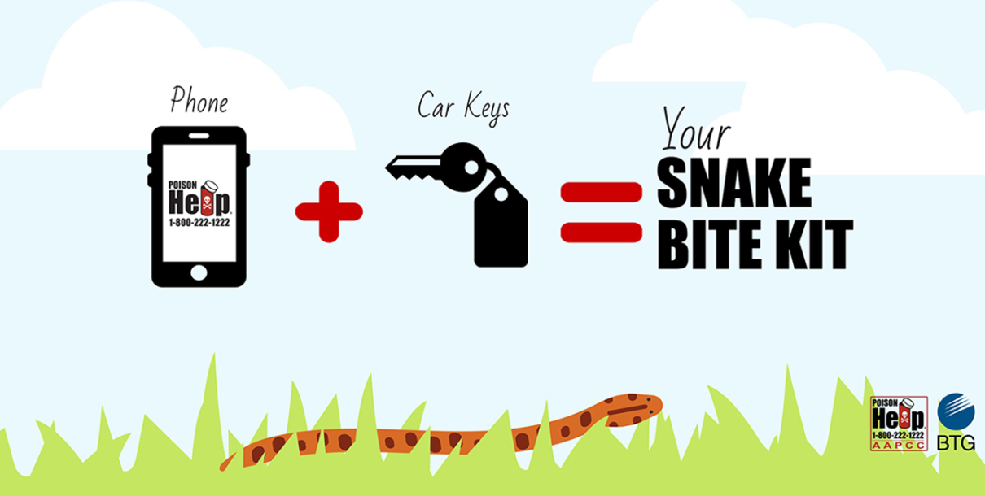
A. Stay calm and go to the nearest hospital.
Notes:
ANSWER: A - Just stay calm and go to the nearest hospital.
DISCUSSION: Many people find snakes to be fascinating… or creepy. Snakes often appear in suspenseful or scary movies and TV shows. A bite is a medical emergency, resulting in a lot of pain and swelling, and victims should seek care. But don’t believe everything you see on film! A lot of snakebite “first aid” we see in movies or TV shows is wrong. The following measures have been studied and shown not to help snakebite victims. In fact, these could even do more harm.
DO NOT:
•Use a tourniquet
•Cut the wound
•Use any form of suction
•Apply ice
•Give the victim drugs or alcohol
•Try to catch, kill, or photograph the snake. The healthcare provider does not need to know what kind of snake bit someone in order to treat them.
The most helpful thing you can do for a snakebite victim is keep them calm and help them get to emergency medical care. Bites from a U.S. snake are rarely fatal.

Slide 14
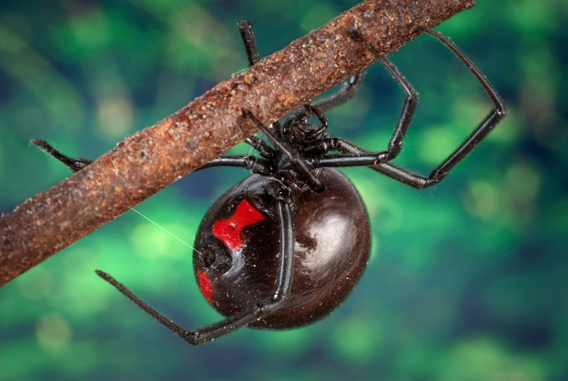
True or False? Only the female black widow spider is dangerous to people.

Slide 15
True.
Notes:
ANSWER: True.
DISCUSSION: Many spiders do not have jaws that are strong enough to pierce human skin. This is true of the male Black Widow Spider.
Black widow spiders are very common all across the United States. And yet, bites are not that common because the spiders rarely leave their web and only bite if they feel threatened. Black widow spider venom is a neurotoxin, meaning it acts on the nervous system. Bites are painful, but rarely fatal. When in spider habitats (dark, undisturbed places like crawlspaces, barns and sheds, firewood piles, etc.) watch where you put your hands and feet!

Slide 16
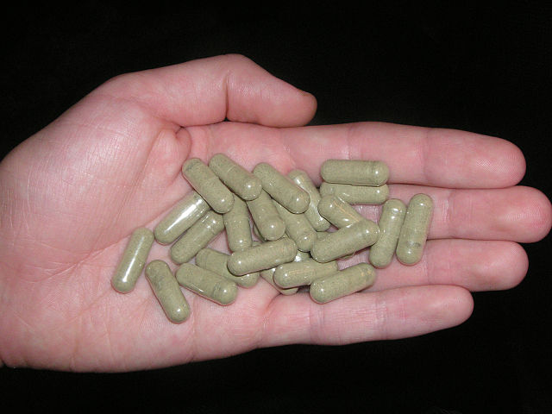
You injured your knee running. One day you see an ad for an herbal product that claims to reduce pain “naturally.” The ad says “it’s not a drug; it’s made from a plant found in the rain forest,” and therefore cannot harm you. Is this true—things that are ‘natural’ cannot harm you? YES or NO?

Slide 17
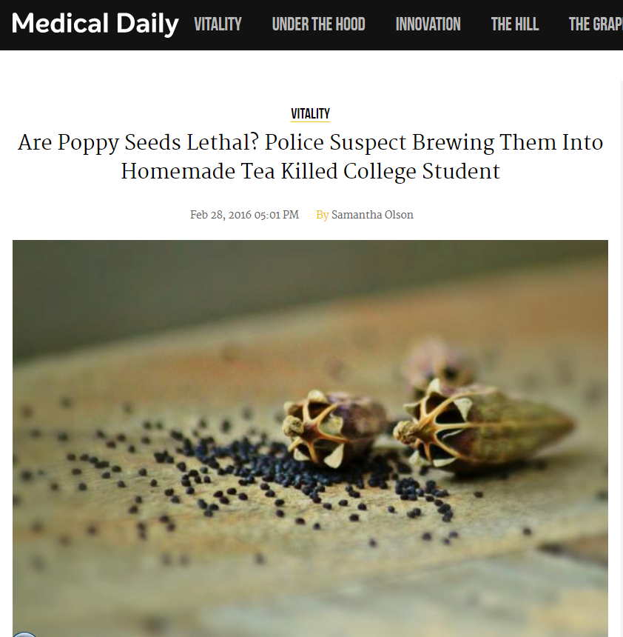
No. ‘Natural’ does NOT mean ‘safe’.
Notes:
ANSWER: No
DISCUSSION: Just because something is ‘natural’ does not mean it is safe. Many medicines, cleaning products, pesticides, and other products are made with ingredients found in nature which could poison you under the right circumstances. Some people believe you cannot be harmed if you ingest or smoke something ‘natural’ in order to get high. In 2016, a college student died after drinking a homemade poppy seed tea that he thought would be a harmless hallucinogen. Eating small amounts of poppy seeds will not hurt you. But if you eat (or drink) a huge amount they could make you very sick or even kill you.

Slide 18
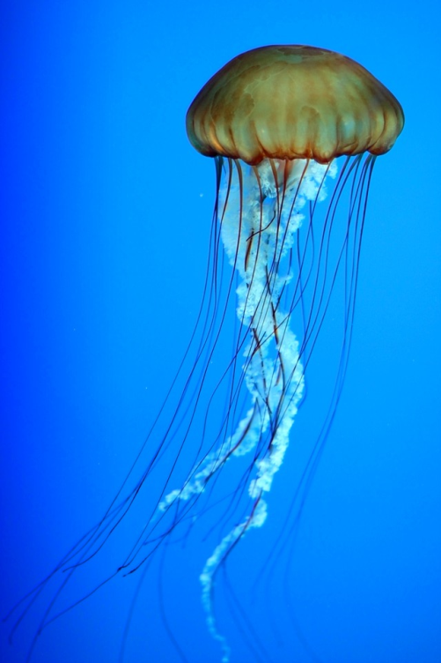
While swimming in the ocean you are stung on the foot by a jellyfish. It really hurts! Which of the following will help relieve the pain?
Apply vinegar to your foot.
Drink vinegar.
Apply bleach to your foot.
Have someone urinate on your foot.

Slide 19
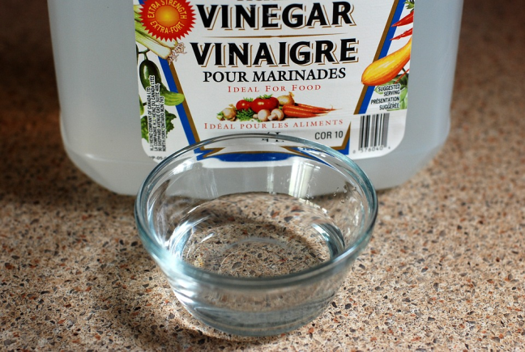
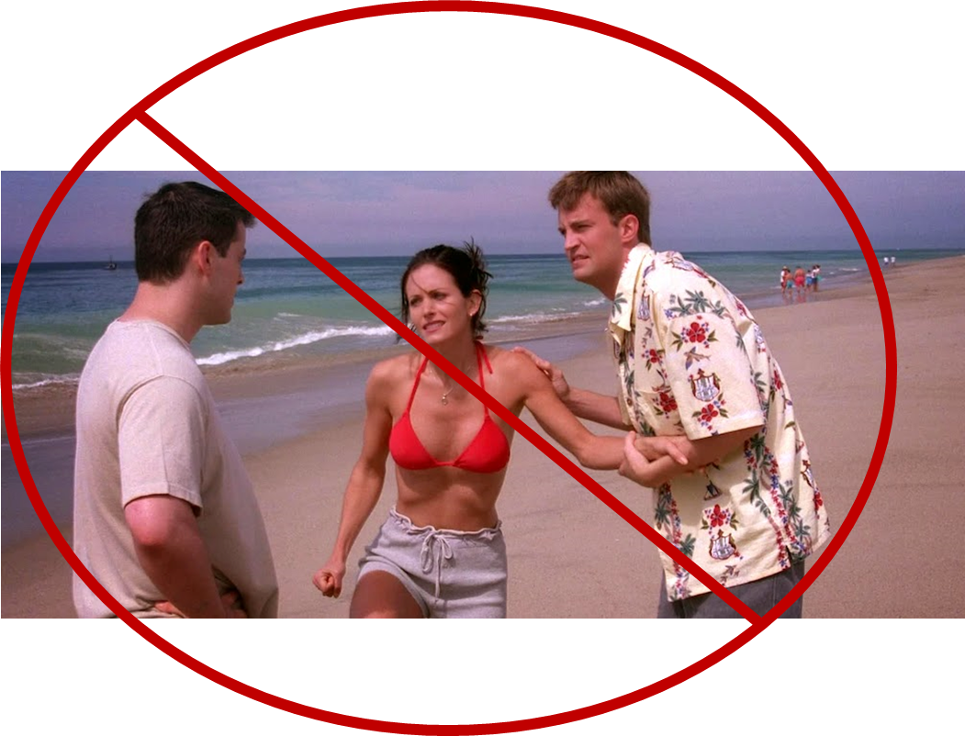
A: Apply vinegar to your foot.
Don’t believe what you see on TV.
[photo: Warner Bros Studio]
Notes:
ANSWER: A- Apply vinegar to your foot.
DISCUSSION: Despite popular myth, urine does not help with stings from stingrays, jellyfish, or any other animal. Don’t get medical advice from TV or movies! [photo: In this episode of Friends, Monica was stung by a jellyfish and Joey urinated on her leg to relieve the pain. In real life, this does not work.]
Vinegar will help relieve the pain. Some beachfront lifeguards keep vinegar in their first aid kit.

Slide 20
Which of the following are most likely to be bitten by a snake?
85 year old senior adults, because they can’t move fast enough to get out of the way.
3 year old children, because they are closer to the ground.
Men.
Math teachers.

Slide 21
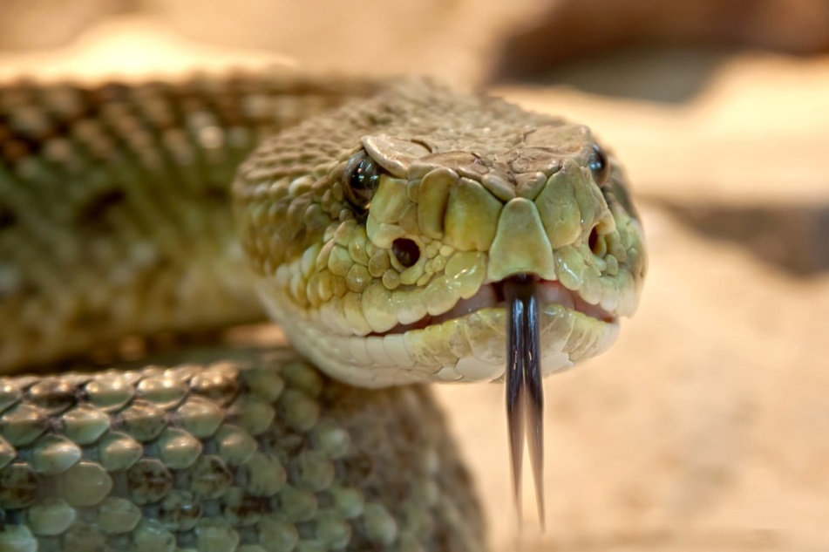
C: Men
Just leave me alone.
I don’t want to bite you!
Notes:
ANSWER: C – Men.
DISCUSSION: Snakes only bite as a last resort when they feel threatened. This can happen when someone does not see the snake and accidentally gets too close. It can also happen when someone is teasing the snake or trying to catch or kill it. Statistically, more men than women are bitten by snakes. This might be because of differences in how men and women, in general, act around snakes.

Slide 22
Which of the following has been linked to teen marijuana use?
Acne
Depression and suicide
Tooth decay
Brain cancer

Slide 23
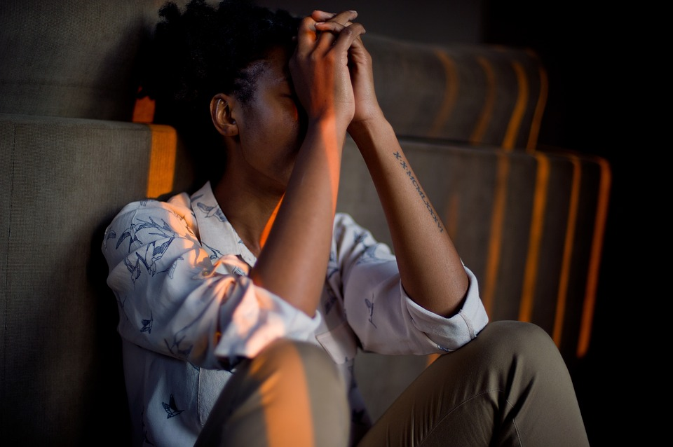
B: Depression and suicide
Notes:
ANSWER: B—Depression and suicide
DISCUSSION: Studies show that marijuana use affects the teen brain differently than the adult brain. This is because the brain is still growing and developing into our early 20’s.
The following have been linked to marijuana use by teens, especially if they use it regularly:
Psychotic disorders including schizophrenia, depression, anxiety disorders, etc.
Thoughts and acts of suicide.
Problems with attention, memory, and problem-solving skills.
Poor school achievement.
Teens are 4-7 times more likely than adults to develop an addiction to marijuana.
Effects may last a long time or even be permanent.
References
Crumley FE. Substance Abuse and Adolescent Suicidal Behavior. JAMA. 1990;263(22):3051–3056. doi:10.1001/jama.1990.03440220075033
Ferdinand, R. F., Sondeijker, F. , Van Der Ende, J. , Selten, J. , Huizink, A. and Verhulst, F. C. (2005), Cannabis use predicts future psychotic symptoms, and vice versa. Addiction, 100: 612-618. doi:10.1111/j.1360-0443.2005.01070.x

Slide 24
You are on vacation in California and need to call poison control. What should you do?
Call information or search the internet to get the correct number for the California Poison Center, otherwise there may be an additional charge.
Call the Georgia Poison Center number you have stored in your phone.

Slide 25
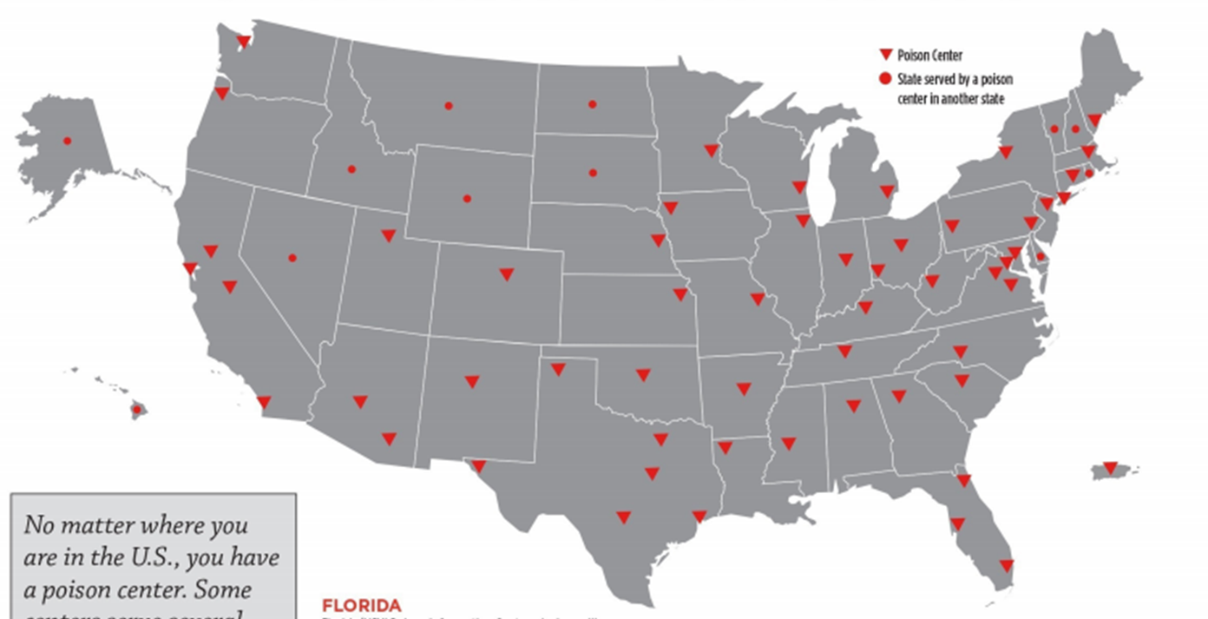
B: Call the Georgia Poison Center number. It’s the same.
Many poison centers—but only one number.
Notes:
1-800-222-1222 is a national hotline number that is the same everywhere in the U.S.! It is always a free call.
This is a map of the U.S. poison centers. Many poison centers; but only one number.

Slide 26
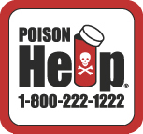
Who answers the phone when you call the poison center at 1-800-222-1222?
Nurses, doctors, pharmacists and other healthcare professionals with special training in treating poisonings.
A secretary who will take a message and have an expert call you back.
The 9-1-1 operator.

Slide 27
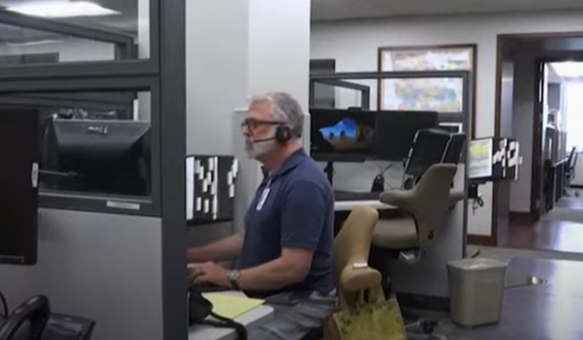
A: Nurses, doctors, pharmacists and other healthcare professionals with special training in treating poisonings.
Notes:
ANSWER: Nurses and doctors with special training in handling poisonings.
DISCUSSION: Callers get immediate help with their concerns, day or night. In fact, other nurses and doctors often reach out to the poison center for advice in treating their own poisoned patients.
Here is one of the Georgia Poison Centers staff. Call us if you need to: they are smart, and friendly, and eager to help you!

Slide 28
True or False? The only way to get help from the poison center is by calling them on the phone.

Slide 29
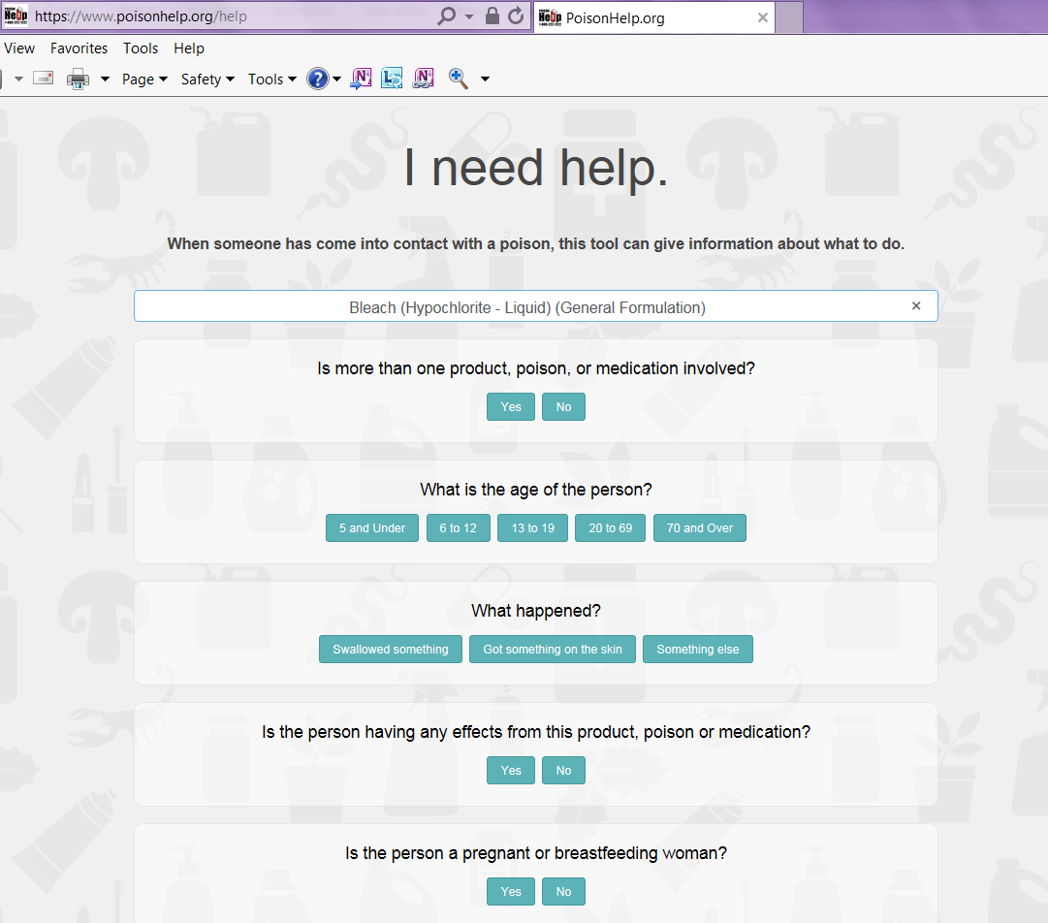
False. Visit www.poisonhelp.org.
Notes:
ANSWER: FALSE
DISCUSSION: There is a website you can visit at www.PoisonHelp.org. Fill out a form about your situation and get immediate answers. Free!

Slide 30
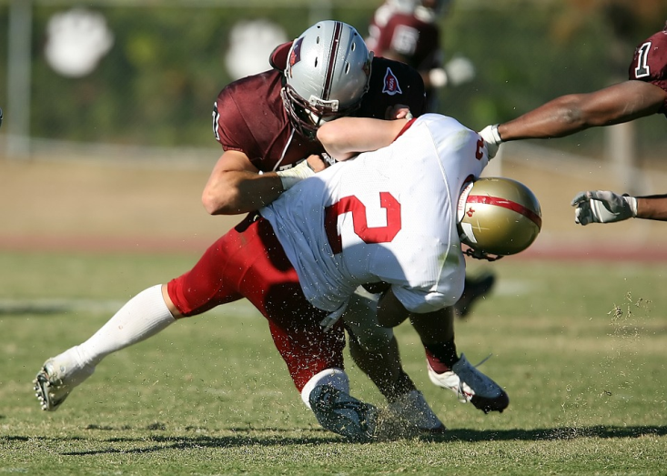
Miguel injured his shoulder playing football. The doctor prescribed an opioid pain medicine with these instructions: “Take one pill every 8 hours.” Miguel took his first dose, but 4 hours later the pain is much worse. What should he do?
Contact the doctor.
Nothing. It’s only been 4 hours.
Take another pill right away, because one probably wasn’t enough.

Slide 31
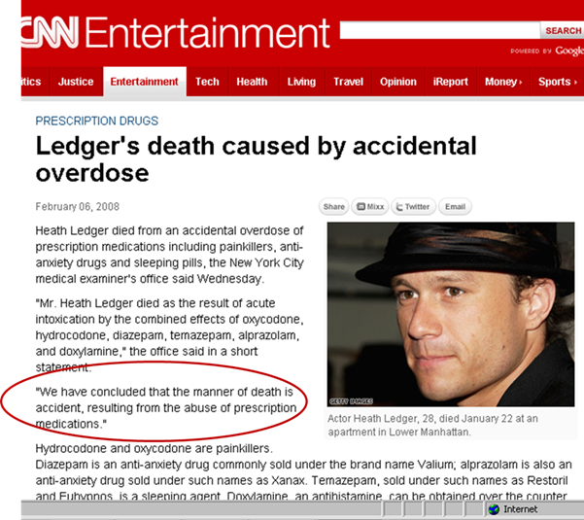
A. Contact the doctor. More is not better.
Notes:
Medicine, both over-the-counter and prescription, can help us recover from injury or illness when taken according to directions. Many people do not think of medicine as poison. However, medicine can be poisonous if we take too much, take it the wrong way, or if taken by the wrong person. It is very important to follow the dosing instructions on all your medicine labels. More is not better!
Actor Heath Ledger died from an accidental overdose of his own prescription medicine. The CDC reports one person dies from an opioid overdose every 11 minutes.

Slide 32
Which of these is the best way to prevent young children from getting into harmful products?
Tell children they are not allowed to handle bottles stored under the sink.
Keep all products stored out of their sight and reach.
Mark all harmful products with a big red “X.”

Slide 33
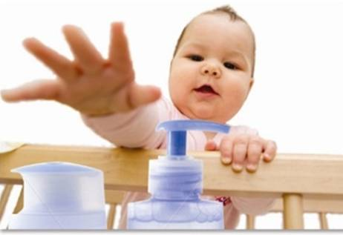
B: Keep all products stored out of their sight and reach.
Notes:
ANSWER: False.
DISCUSSION: There is no such thing as a childproof container. Given enough time, many children can figure out how to open containers – especially if they have watched an adult do it first. Child resistant caps do help, but they aren’t enough on their own. Keep all medicines and household products up high, out of the sight and reach of children.

Slide 34
You are at the playground babysitting a 5 year old. He spots a wild mushroom under a tree, and bends down to pick it. You try to take it from him but he’s too fast—he eats it!
Should you try to make him throw up? Yes or No?

Slide 35
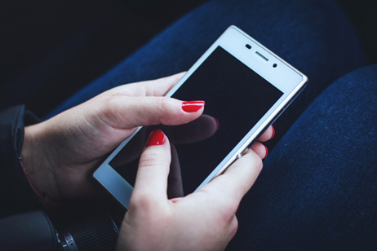
No. Do not try to make someone throw up.
1-800-222-1222
Notes:
ANSWER: NO
DISCUSSION: Forcing someone to throw up when they swallow something harmful does not help and could be dangerous. Instead: call the poison center right away for free, immediate, expert advice on what to do.

Slide 36
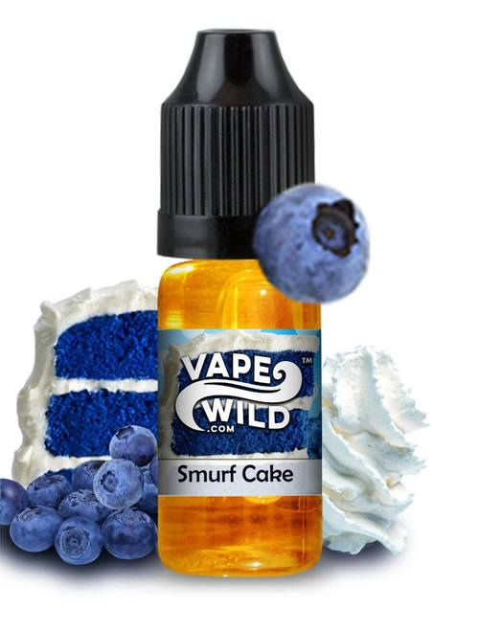
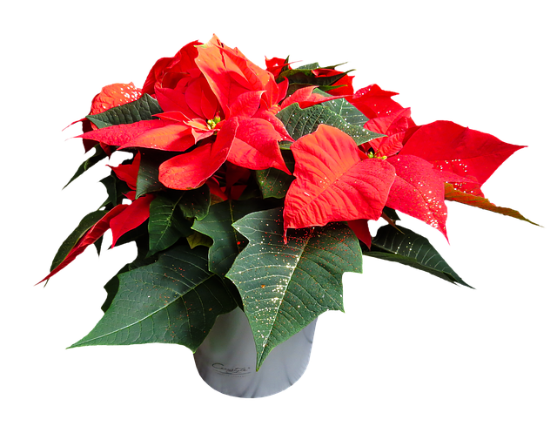
Which of the following could be life-threatening for a small child?
Eating 3 poinsettia leaves.
Swallowing a teaspoon of e-juice.

Slide 37
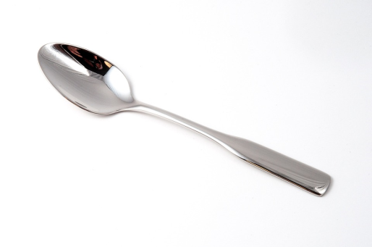
B. One teaspoon of e-juice.
Notes:
ANSWER: Swallowing a teaspoon of e-juice.
DISCUSSION: If the e-juice contains nicotine, one teaspoon is enough to cause serious harm and even death in a small child. Nicotine is very poisonous. Cigarettes, cigarette butts, cigars, and other sources of tobacco can also be dangerous to swallow because of their nicotine content.
Despite their bad reputation, poinsettias are not poisonous to people.

Slide 38
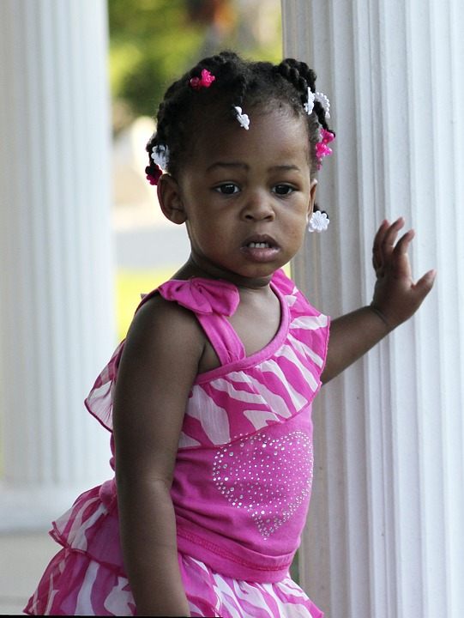
Kisha is a toddler. Grandma comes to visit and brings these items with her. Which one could present a risk of poisoning to Kisha if she put it in her mouth?
Hearing aids.
Gold bracelet.
Stuffed animal from a thrift shop.

Slide 39
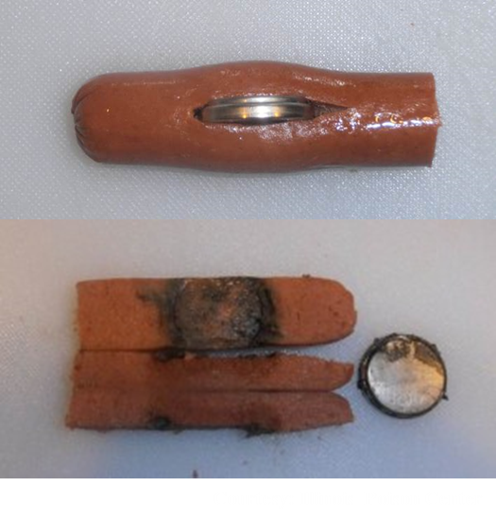
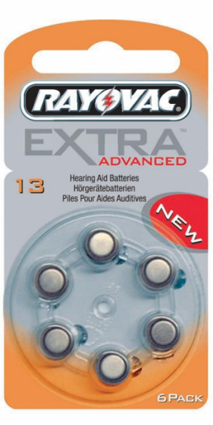
A: Hearing aids -- the batteries inside are dangerous!
Notes:
ANSWER: A - Hearing aids. This is because of the button batteries inside.
DISCUSSION: Small, shiny button batteries (also called ‘disk batteries’) are attractive to children. They can cause burns to the throat and esophagus if swallowed and then become stuck. The photos on the slide show what happened to a hot dog after a button battery was placed inside for only 3 hours. Can you see the burns? Imagine if this was a child’s throat!

Slide 40
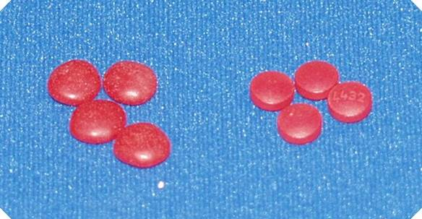
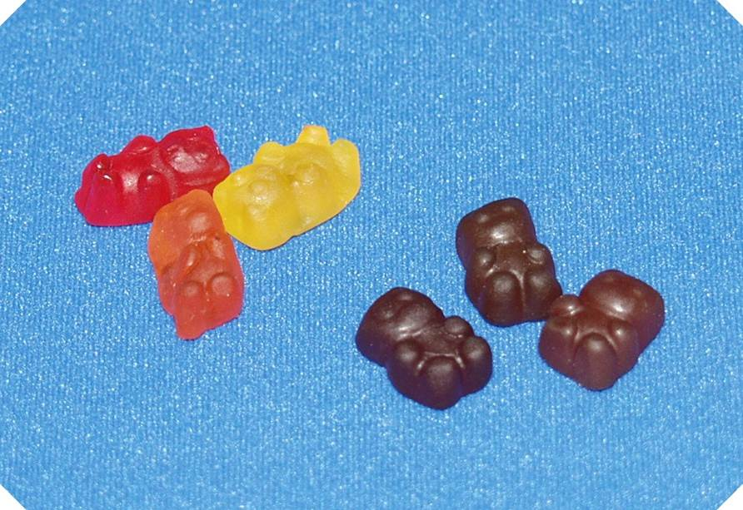
In the 2 pictures below, pills and candies that look alike are shown side by side. In each image, are the pills on the left (L) or the right (R)?
L
R
L
R

Slide 41
The pills are on the right (R).
Candy
Pills
Candy
Pills
Notes:
ANSWER: R—The pills are on the right.
DISCUSSION: Pills and candy look very similar. Young children cannot tell the difference. Never encourage a child to take their medicine or vitamins by calling it "candy." That approach may make it easier to get them to swallow it, but it may lead to a poisoning later. Tell children that medicine is medicine, and that only trusted adults can give medicine to them. Also keep all medicines and vitamins stored up high, out of the sight and reach of children. Guests may bring their medicines with them into your home, so give guests a safe place to store personal belongings.

Slide 42
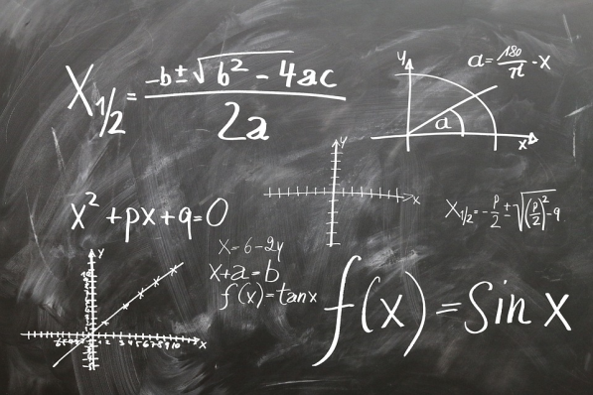
You have been diagnosed with Attention Deficit Disorder (ADD) and take prescription medicine to help you focus.
Your friend Abby asks if she can have some of your medicine to help her stay up late and concentrate on studying for an algebra test. She says that since a doctor prescribed the pills, they must be safe.
Yes or No—is it true that Abby
can safely take your medicine?

Slide 43
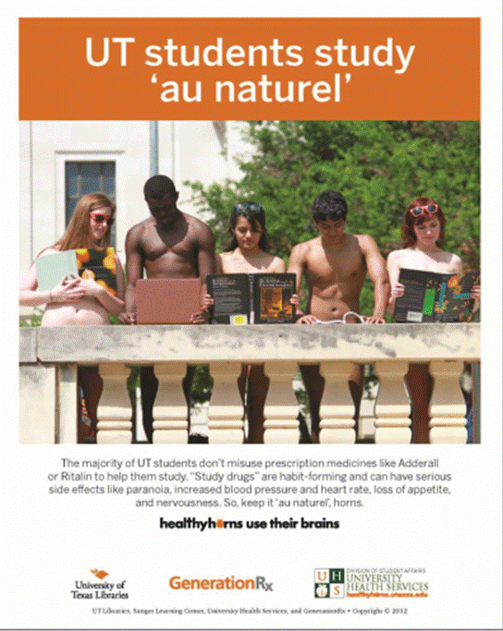
No. Sharing pills is dangerous. It is also illegal.
Notes:
ANSWER: NO
DISCUSSION: The medicine will not work the same way if Abby takes them, and she could have harmful side effects. Sharing pills is dangerous. Sharing prescription medicine is also illegal.

Slide 44
True or False? E-cigarettes and vapes produce nothing more than harmless water vapor with flavoring.

Slide 45
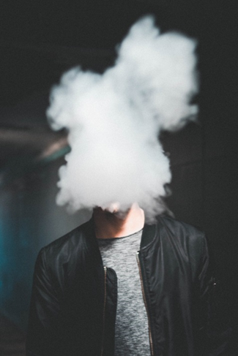
False
Notes:
ANSWER: FALSE
DISCUSSION: There are more than 30 identified chemical ingredients known to be in the aerosol produced by an e-cigarette or other vaping device. Here are some of them:
Heavy metals such as lead, nickel, and tin.
Formaldehyde (a chemical used to preserve dead bodies).
Carcinogens linked to cancer.
Diacetyl, a flavoring chemical linked to a disease called ‘popcorn lung.’
Ultra-fine particles.
Volatile organic compounds.
Nicotine, an addictive chemical that harms the developing brains of children and teens.
E-cigarettes and vapes have only been around since 2011. Many studies are underway, but we still don’t know exactly what these ingredients are doing to our bodies. Scientists have not had enough time to see the long term effects.

Slide 46
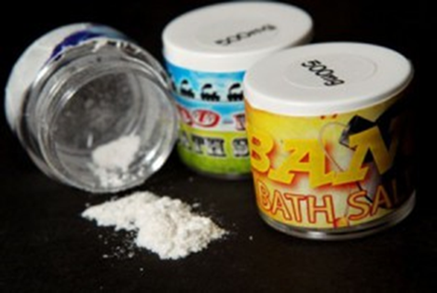
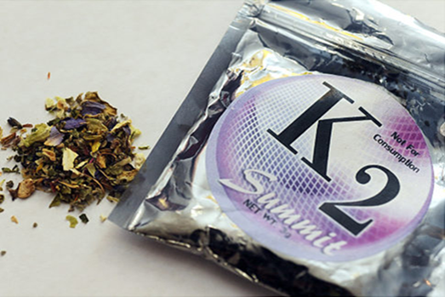
Which of the following are common side effects from synthetic drugs like ‘bath salts’ ‘K2,’ or ‘Spice?’
Panic attack.
Depression and a strong urge to kill oneself.
Frightening hallucinations.
All of the above.

Slide 47
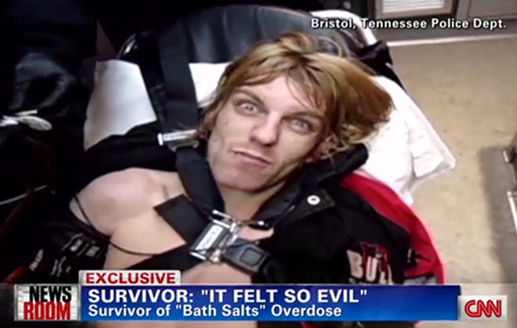
D. All of the above.
Notes:
ANSWER: D – All of the above. Side effects can also re-occur days or even months later without warning.
DISCUSSION: Some people think designer drugs like Spice, K2, and bath salts are safe because they are made with “natural” ingredients. In fact they contain chemicals manufactured by criminals in secret labs and have never been tested for safety. These drugs have been responsible for many hospitalizations and deaths. Here are some common side effects reported:
Agitation, panic attacks.
Extreme paranoia.
Frightening hallucinations.
Dangerously elevated blood pressure, temperature, and heart rate.
Violent episodes.
Harm to self or others.
Mental illness that was not there before.
Note: Side effects can last for days, and they can re-occur months later with no warning.

Slide 48
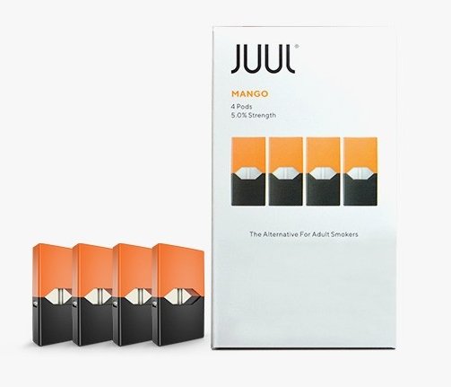
True or False?
One mango flavored JUUL cartridge (“Juul pod”) contains the same amount of nicotine as an entire pack of cigarettes.

Slide 49
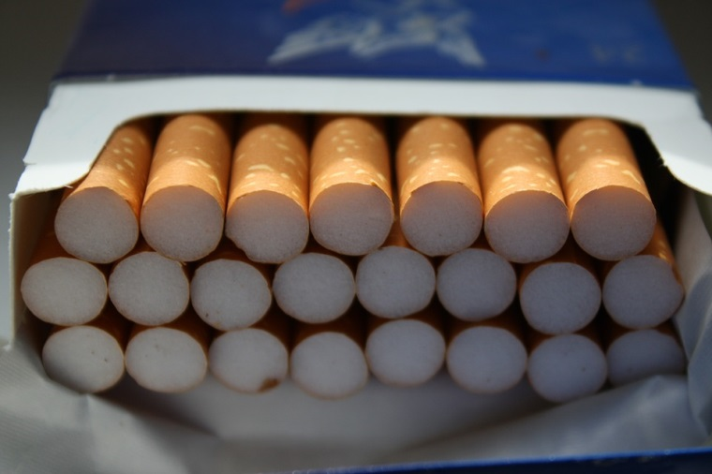
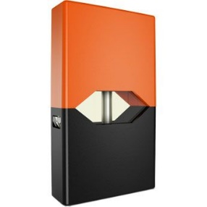
TRUE
=
Notes:
ANSWER: True
DISCUSSION: One JUUL pod of any flavor contains 5% nicotine, and lasts for about 200 puffs, according to the manufacturer (www.juul.com). This is equivalent to one entire pack of cigarettes. According to a study by The Truth Initiative, 63% of Juul users do not know that all Juul pods contain nicotine. (www.truthinitiative.org). Nicotine is very addictive and harms the brain.

Slide 50
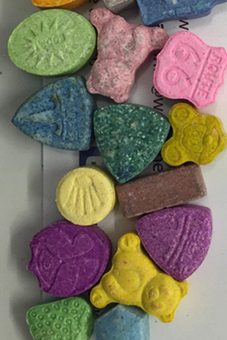
How can you be certain that the designer drug molly you just purchased at a concert is safe?
Because you know and trust the seller.
Because molly is pure MDMA (also known as ecstasy). Therefore it produces a ‘clean high.’
Because you purchased it before and had no problems.
This is not possible.
Notes:
DISCUSSION: Manufacturers of designer drugs-- like molly and others-- are criminals operating in secret labs. They change the recipes often to stay ahead of new laws banning the products. They also sneak other, cheaper ingredients into their product as fillers to increase profits, including cough medicine, cocaine, fentanyl (a deadly opioid), and rat poison. Products are never tested for safety or even for how they will affect people.
You cannot tell the purity, strength, or ingredients of any illicit drug or black market pill just by what it looks like, by the reputation of the seller, or because you purchased a similar product before. When you use any pill or substance purchased illicitly, you have NO IDEA what you are really getting.
Even if you do have ‘pure’ Molly it is not safe to take. Side effects from Molly (and ecstasy) may include nausea, muscle cramps, involuntary teeth clenching, blurred vision, chills, a spike in body temperature that could result in dehydration, liver, kidney, or heart failure or even death.

Slide 51
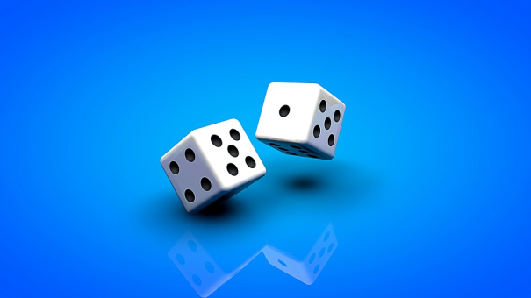
C: This is not possible. When you use any pill or substance purchased illicitly, you have NO IDEA what you are really getting.
Notes:
DISCUSSION: Manufacturers of ‘designer drugs’ like K2, Spice, “bath salts,” Molly, etc. are criminals operating in secret labs. They change the recipes often to stay ahead of new laws banning the products. They also sneak other, cheaper ingredients into their product as fillers to increase profits, including cough medicine, cocaine, fentanyl, and rat poison. Some don’t contain any Molly at all. Products are never tested for safety or even for how they will affect people.
You cannot tell the purity, strength, or ingredients of any illicit drug or black market pill just by what it looks like, by the reputation of the seller, or because you purchased a similar product before. Onsite test kits are unreliable. When you use any pill or substance purchased illicitly, you have NO IDEA what you are really getting.

